Slide 1
Data Analyst Nanodegree
Session 7
Conducted by: Hamza
Notes:
https://udacity.zoom.us/j/7991233356
<number>

Slide 2
Agenda
Project
Statistics recap
Lies with visuals
Exploring resources
Creating visuals
Breakout rooms
Tableau prep a perfect 1 min video https://elearning.tableau.com/path/analyst-learning-path/get-started-with-tableau/896558/scorm/3s44dv89zz8aq

Slide 3
BBC visuals
https://www.youtube.com/watch?v=jbkSRLYSojo
1. Dr. Rosling concludes that the analysis involved plotting “120,000 numbers.” Explain where the 120,000 count came from.
2. List the attributes that you believe must be stored in a database that supports this analysis (and perhaps similar analyses)
3. Give candidate (tentative) relational schema (at least two) for a database that would support this and similar analyses

Slide 4
Breakout room
Visuals lie

Slide 5
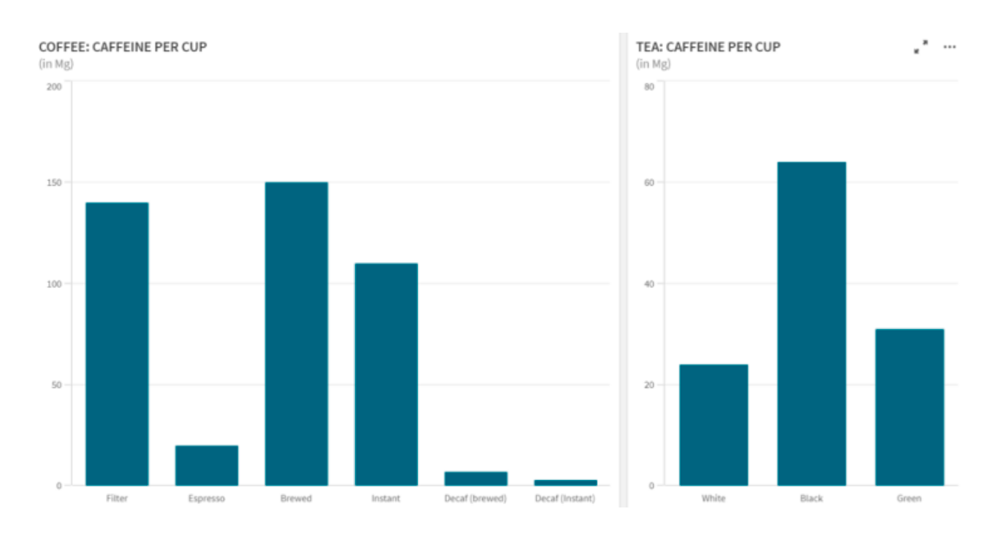
More caffeine, brewed coffee or tea?
Notes:
https://www.linkedin.com/pulse/how-lie-visualization-stephen-redmond/

Slide 6
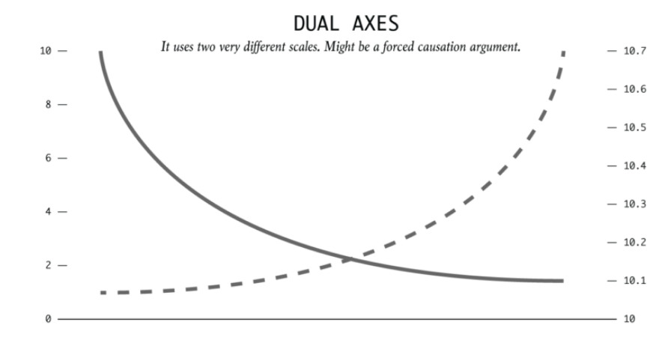

Slide 7
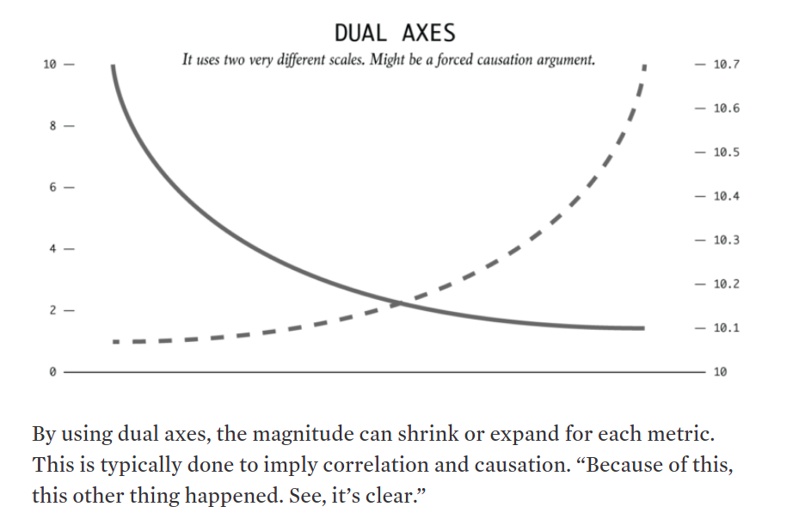

Slide 8
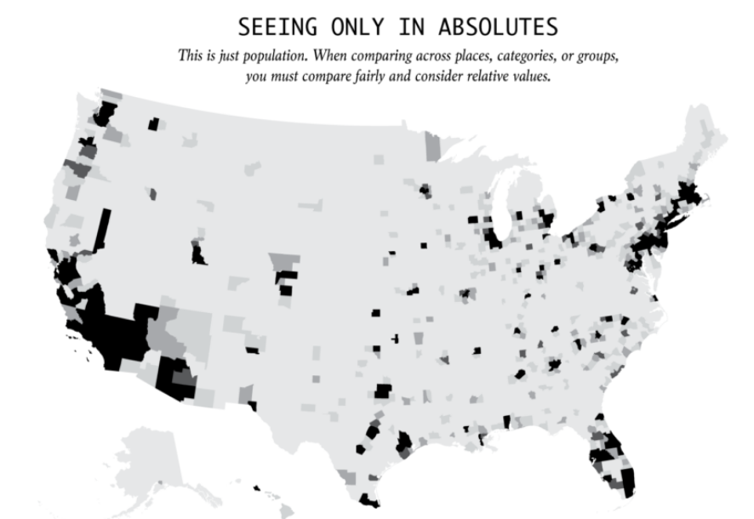
https://flowingdata.com/2017/02/09/how-to-spot-visualization-lies/

Slide 9
https://flowingdata.com/2017/02/09/how-to-spot-visualization-lies/
Everything is relative. You can’t say a town is more dangerous than another because the first one had two robberies and the other only had one. What if the first town has 1,000 times the population that of the first? It is often more useful to think in terms of percentages and rates rather than absolutes and totals.

Slide 10
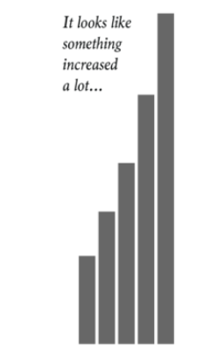
https://flowingdata.com/2017/02/09/how-to-spot-visualization-lies/

Slide 11
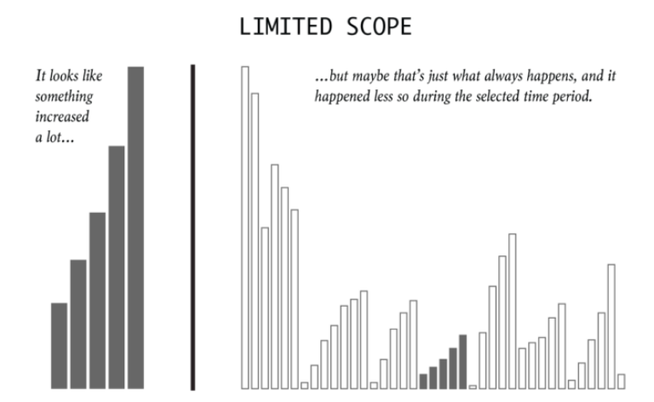
https://flowingdata.com/2017/02/09/how-to-spot-visualization-lies/
It’s easy to cherrypick dates and timeframes to fit a specific narrative. So consider history, what usually happens, and proper baselines to compare against.

Slide 12
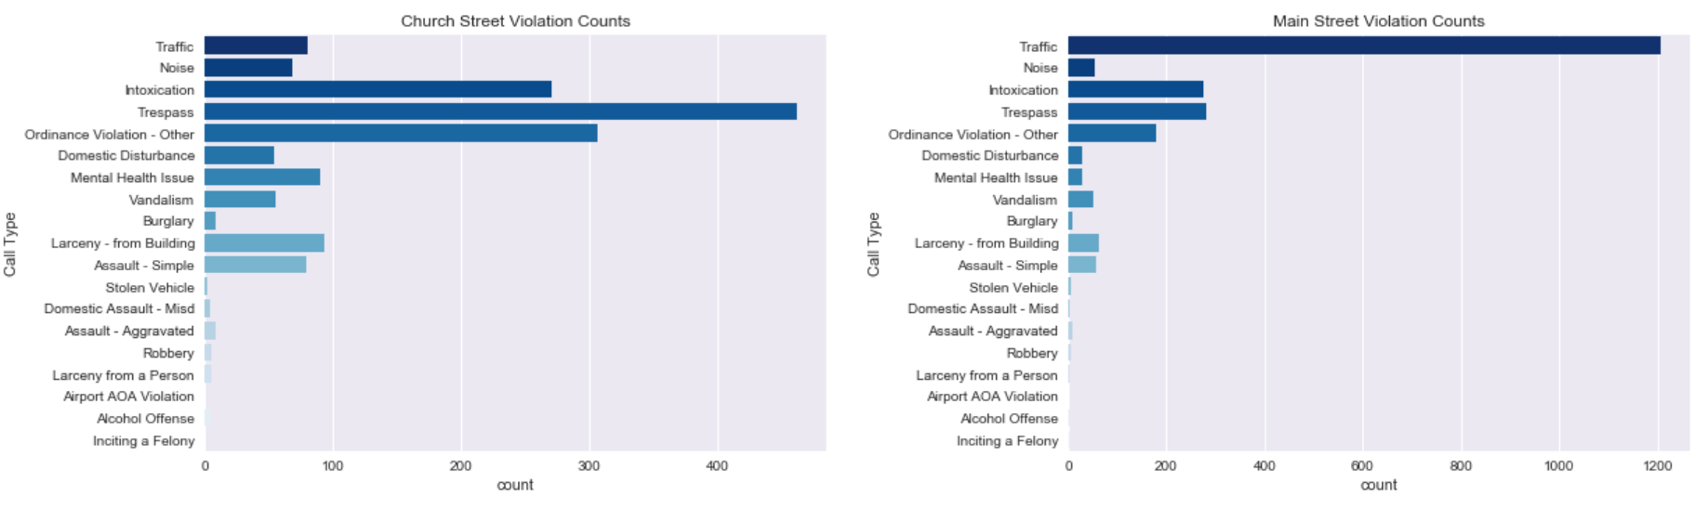
Notes:
Above it looks like Church Street beats Main Street on trespassing by a factor of four, but below when we scale them to the same scale it is clear that the amount of trespassing is much closer to being the same. It is also much clearer that thanks to traffic incidents there, Main Street has more violations in total, something the initial charts at a glance would not tell you.

Slide 13
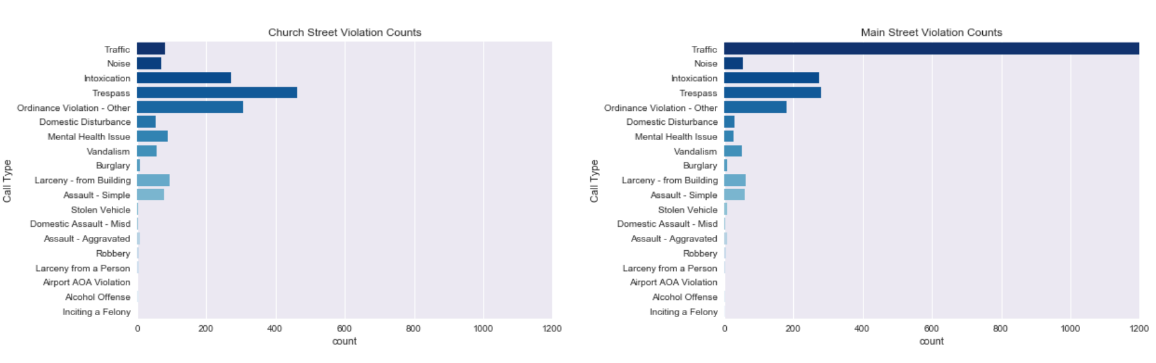
Corrected graph
https://towardsdatascience.com/5-ways-data-visualizations-can-lie-46e54f41de37

Slide 14
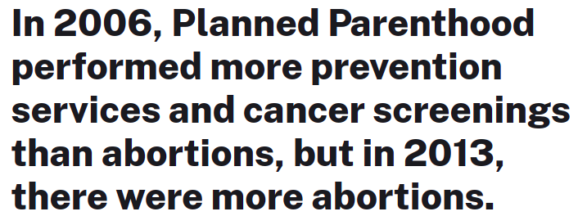
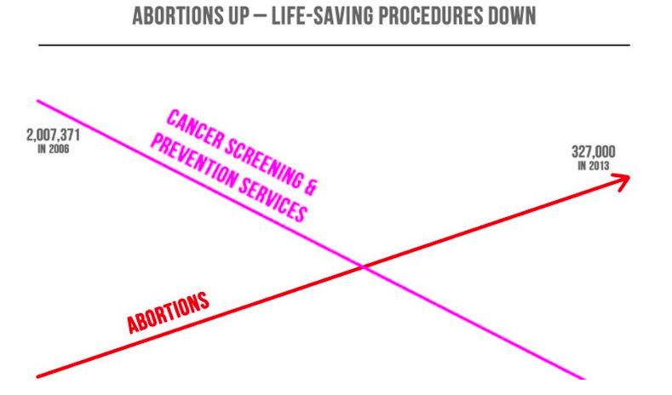

Slide 15
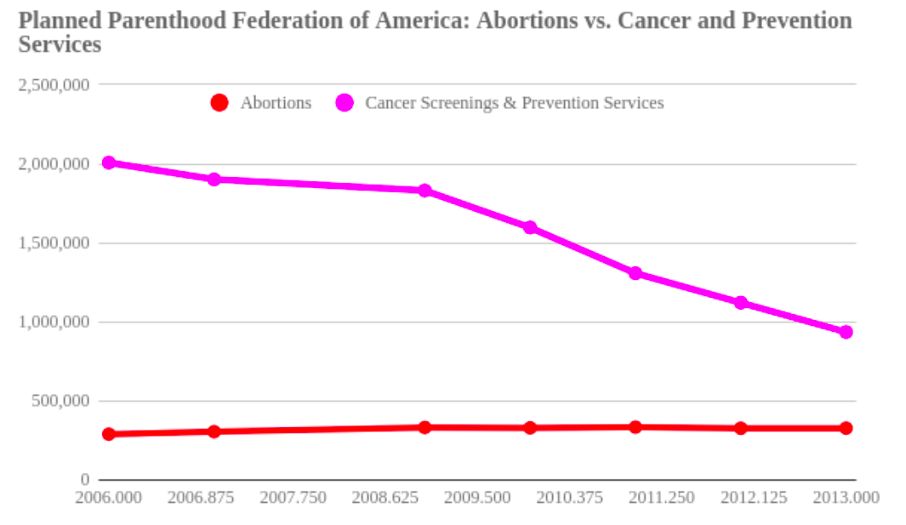
Dual axis
https://www.politifact.com/factchecks/2015/oct/01/jason-chaffetz/chart-shown-planned-parenthood-hearing-misleading-/
Notes:
As you can see from the chart, the number of abortions provided by Planned Parenthood has essentially held steady, with marginal increases and a modest peak in 2009. It is true, however, that the organization now provides fewer cancer screenings and preventive services, though medical experts said that’s more likely due to changing health guidelines than the organization prioritizing abortions.

Slide 16
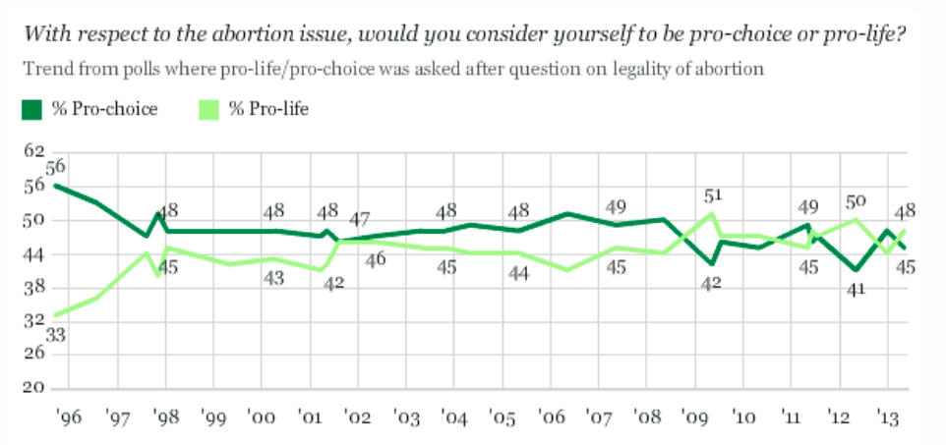
What u think?

Slide 17
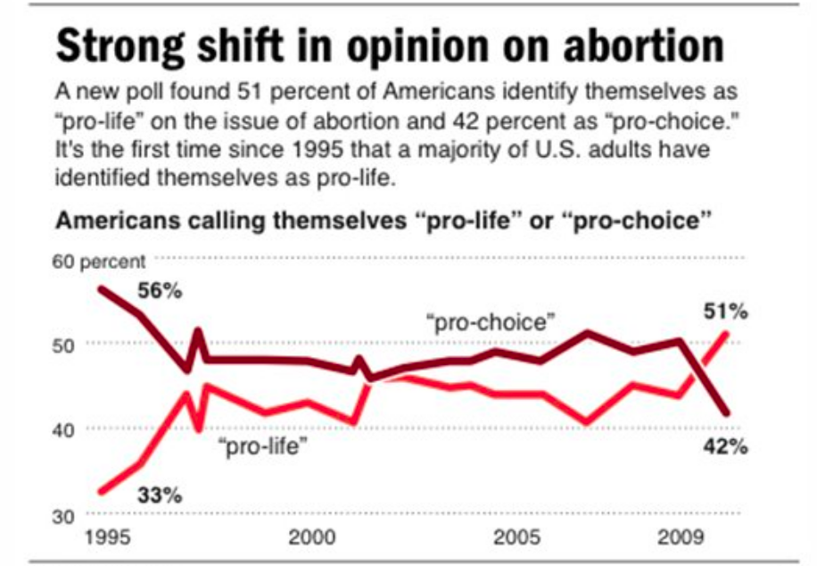
And now?
https://visualisingadvocacy.org/node/643.html

Slide 18
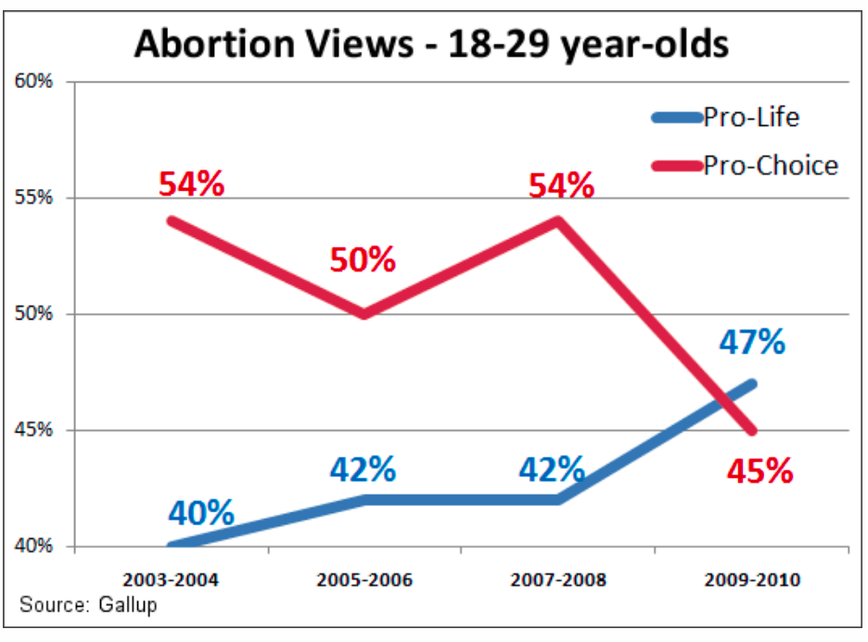
Play more?

Slide 19
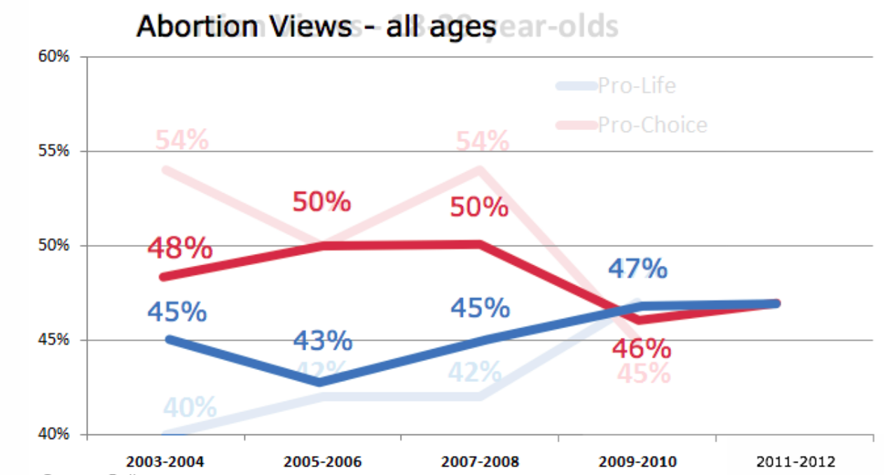
Looks better?
Age
End point

Slide 20
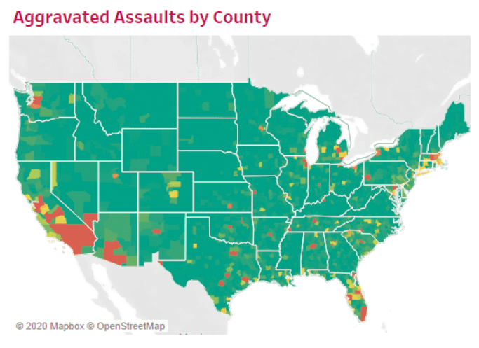
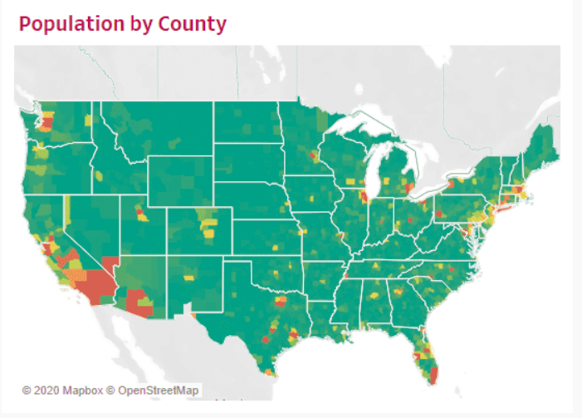
Anything wrong?

Slide 21
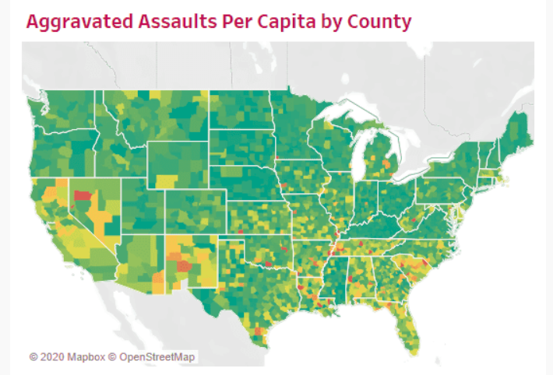
Solution
https://www.tessellationtech.io/top-five-ways-mislead-data-visualization/
لكل فرد

Slide 22
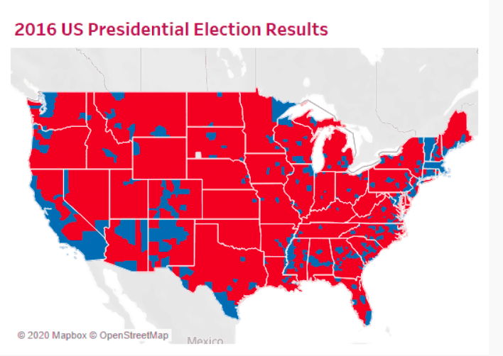
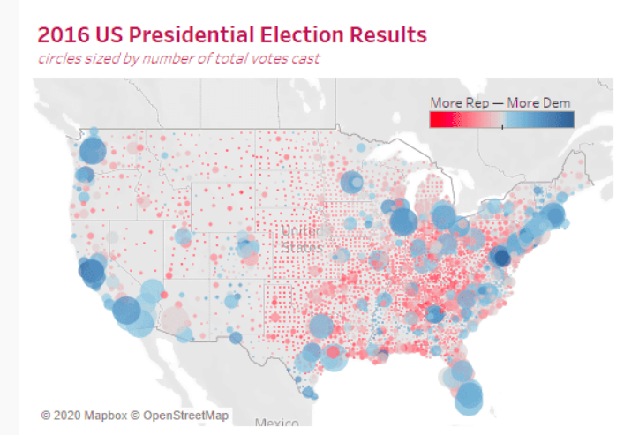
Which is better
https://www.tessellationtech.io/top-five-ways-mislead-data-visualization/
Notes:
The raw data tells a different story: the Democratic candidate, Hillary Clinton, actually received more votes than her Republican counterpart, which is impossible to tell from the map above without outside knowledge. Another issue with the map above is that it views things as black and white (or red and blue) and ignores the fact that some people in Blue counties voted Red and vice versa.
This map is much more nuanced. It colors counties according to the proportion of the county that voted Republican or Democrat. Additionally, I abstracted each county as a circle and sized the circles by the total number of votes cast in that county. While a view like this is not perfect, it tells a clearer story than our absolutist map above.

Slide 23
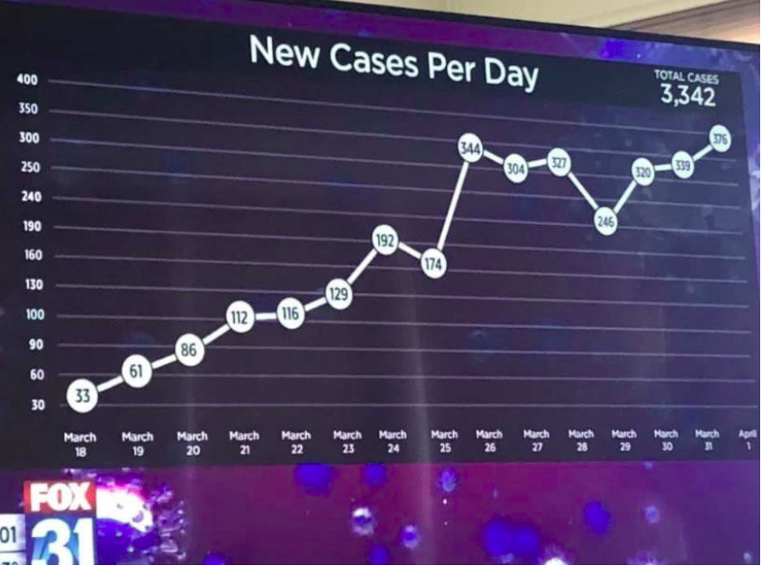
Anything wrong?

Slide 24
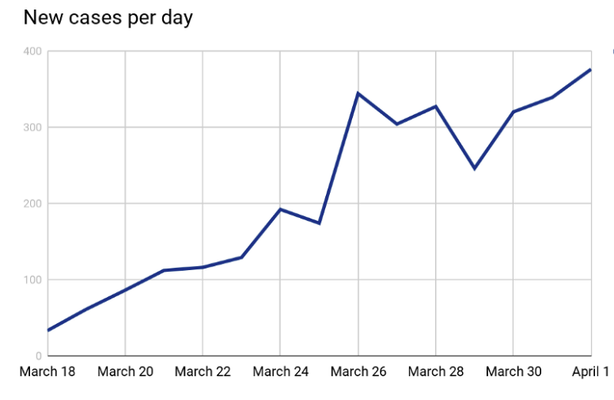
دنيا تانية؟
https://medium.com/nightingale/bad-data-visualization-in-the-time-of-covid-19-5a9f8198ce3e

Slide 25
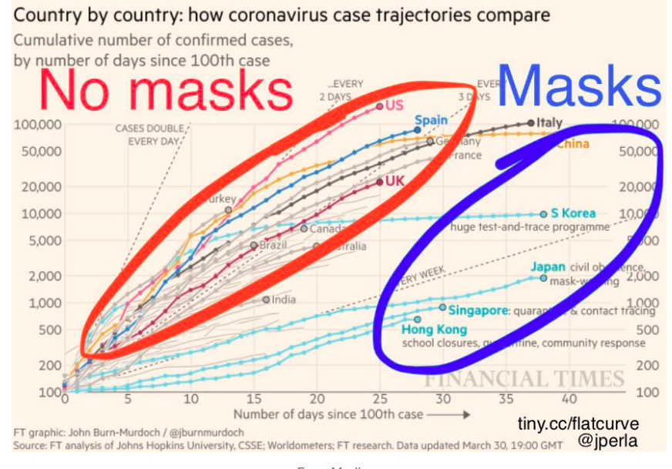
Anything wrong?

Slide 26
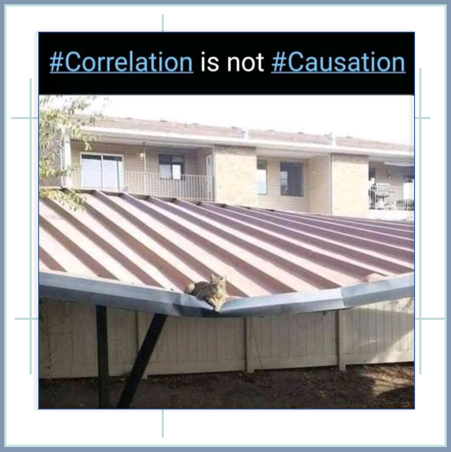
“it makes a lot of intuitive sense that masks slow the spread of COVID-19, right?”

Slide 27
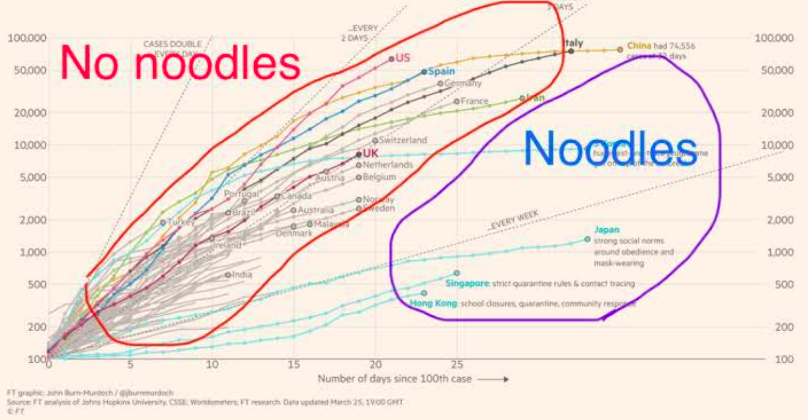
What about this?
Notes:
Causes:
State capacity is the ability of a government to accomplish policy goals, either generally or in reference to specific aims. A state that lacks capacity is defined as a fragile state or, in a more extreme case, a failed state.
Or previous exposure to SARS made them better prepared

Slide 28
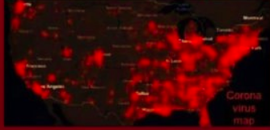
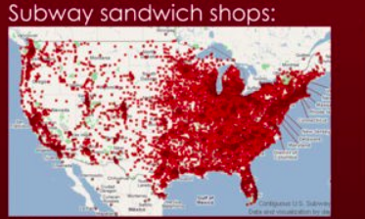
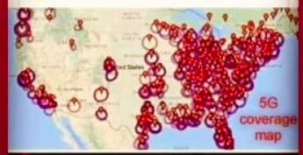
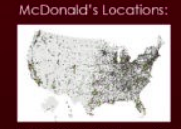
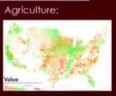
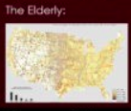

Any pattern?

Slide 29
Failure to normalize
Bad Data Visualization in the Time of COVID-19 | by Danny D. Leybzon | Nightingale | Medium
https://medium.com/nightingale/bad-data-visualization-in-the-time-of-covid-19-5a9f8198ce3e

Slide 30
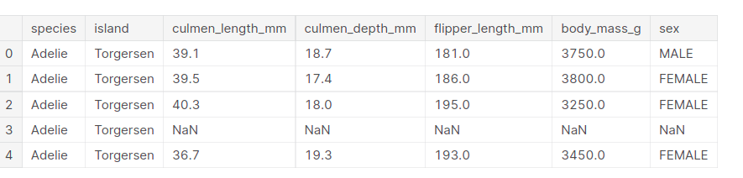
penguins
How to visualize?

Slide 31
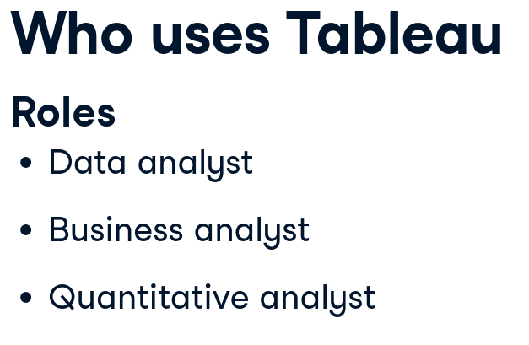

Notes:
Most common job titles
https://campus.datacamp.com/courses/introduction-to-tableau/getting-started-with-tableau?ex=1

Slide 32
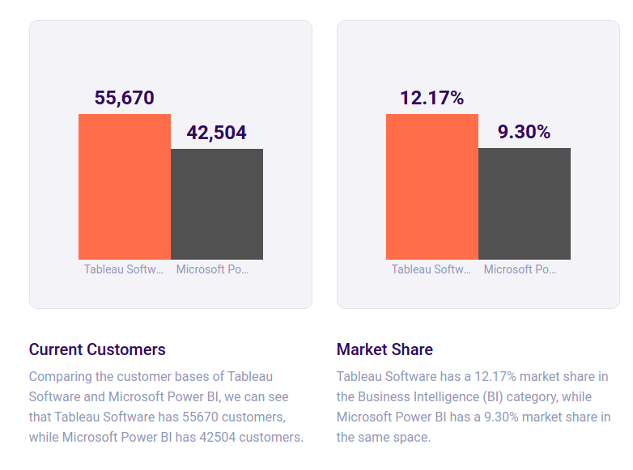
Market share (Slintel)
Notes:
https://www.slintel.com/tech/business-intelligence-bi/tableausoftware-vs-microsoftpowerbi

Slide 33
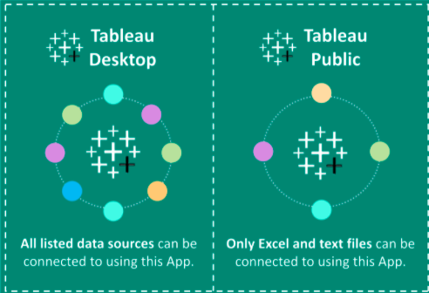
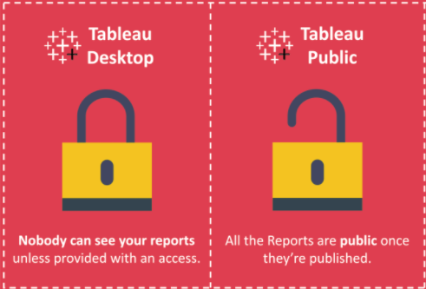
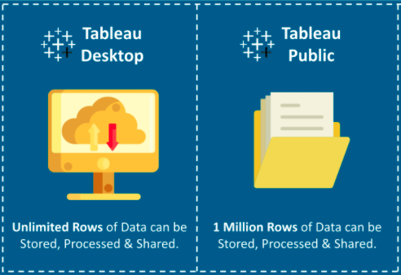
Public vs desktop
Notes:
Need to check if tableau pubic supports only these files

Slide 34

Notes:
https://public.tableau.com/app/profile/datacamp.introduction.to.tableau#!/

Slide 35
Two main aims
1- given data, which graphs to choose (seaborn and visual vocab)
2- given graphs, can u come up with data? (reverse engineering visual graphs)
Mention that reverse engineering is available in BBC guide
Task 1 crosswords based on datacamp exercise
Task 2 get data, choose graph without drawing from visualvocab

Slide 36
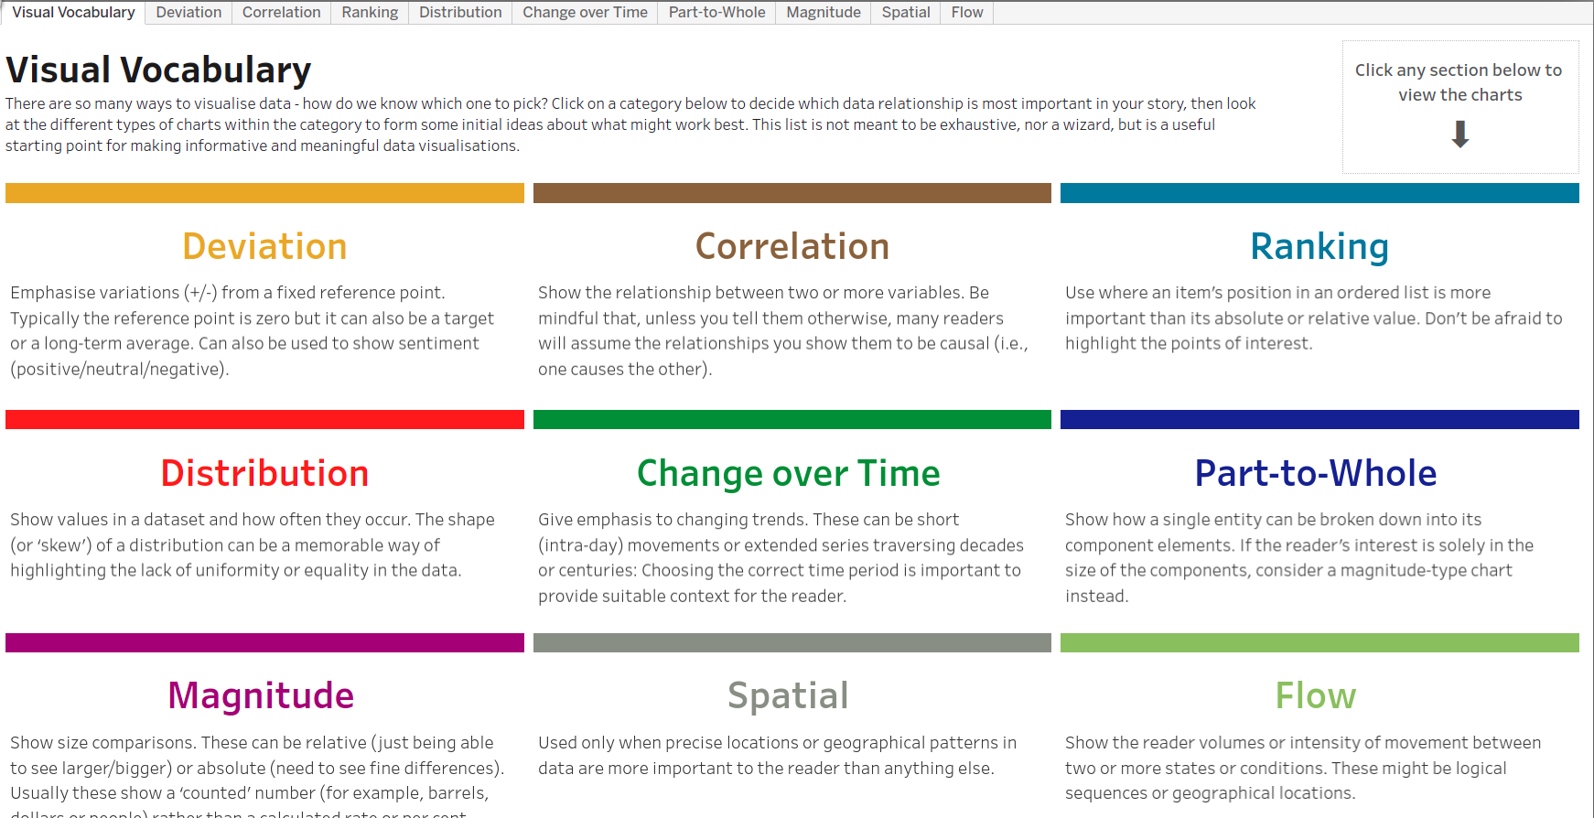
Visual vocabulary
https://public.tableau.com/views/VisualVocabulary/VisualVocabulary?%3AshowVizHome=no

Slide 37
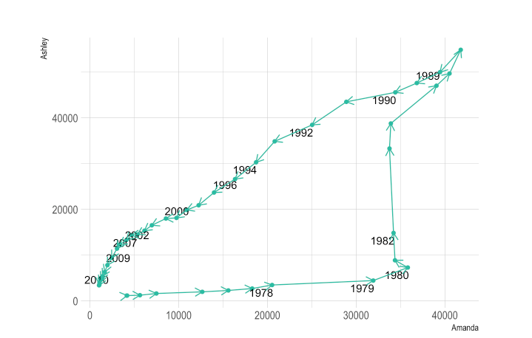
Connected Scatterplot – from Data to Viz
https://www.data-to-viz.com/graph/connectedscatter.html

Slide 38
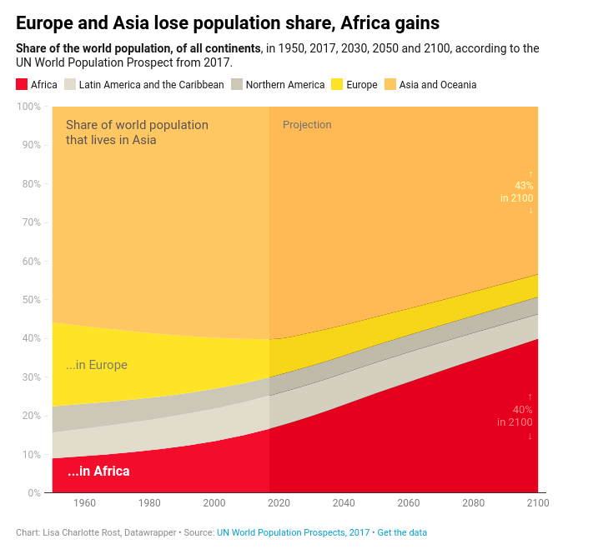
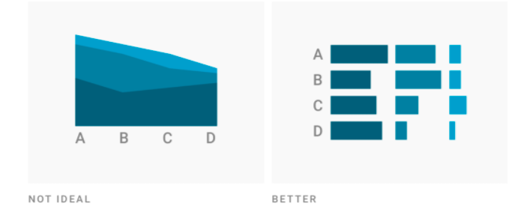
Line vs area vs barchart
https://blog.datawrapper.de/area-charts/
Notes:
This chart has only five values, so in most cases, a stacked column chart might be a better choice. However, the intervals between the years differ (e.g. between 2017 & 2030 and between 2050 & 2100). Area Charts have axes with continuous scales that will show the dates in the right intervals; column charts don’t.
In this case, an area chart is also a better choice than a line chart. That’s because the differences between the values are big enough, so the trend can be seen well enough. Also, readers will recognize faster than in a line chart that this chart is about shares instead of absolute values.

Slide 39
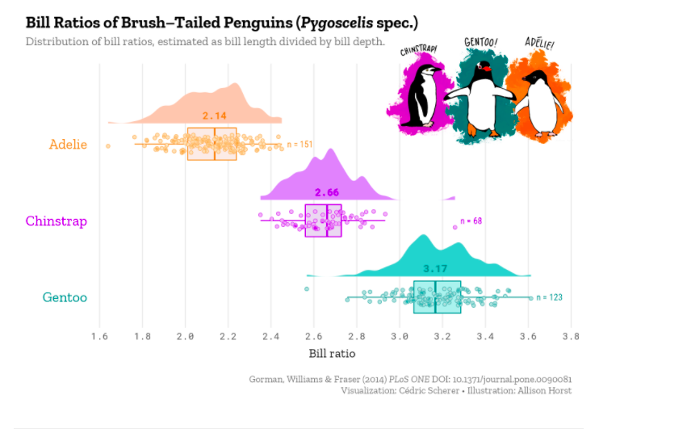
Raincloud plot
Read the tutorial
https://www.cedricscherer.com/2021/06/06/visualizing-distributions-with-raincloud-plots-and-how-to-create-them-with-ggplot2/

Slide 40
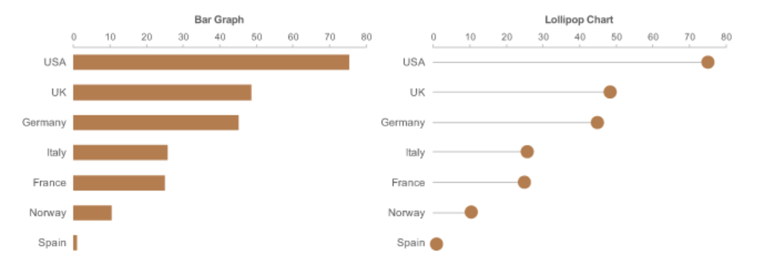
Which is better?
https://www.perceptualedge.com/blog/?p=2642
Notes:
Bar charts clunky when having too many categories
Lollipop not
Lollipop head is not precise

Slide 41
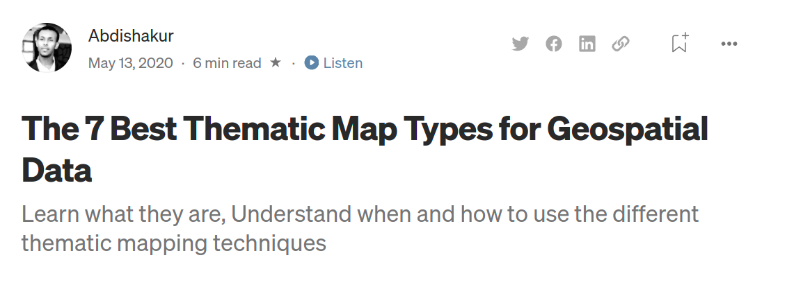
Maps
https://towardsdatascience.com/the-7-best-thematic-map-types-for-geospatial-data-34d21b8b475

Slide 42
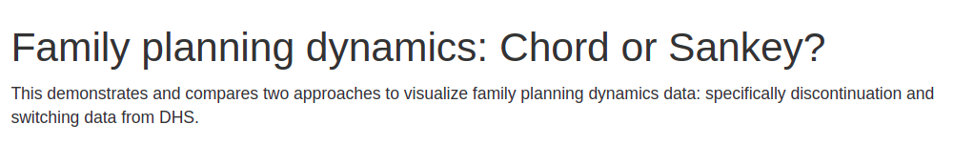
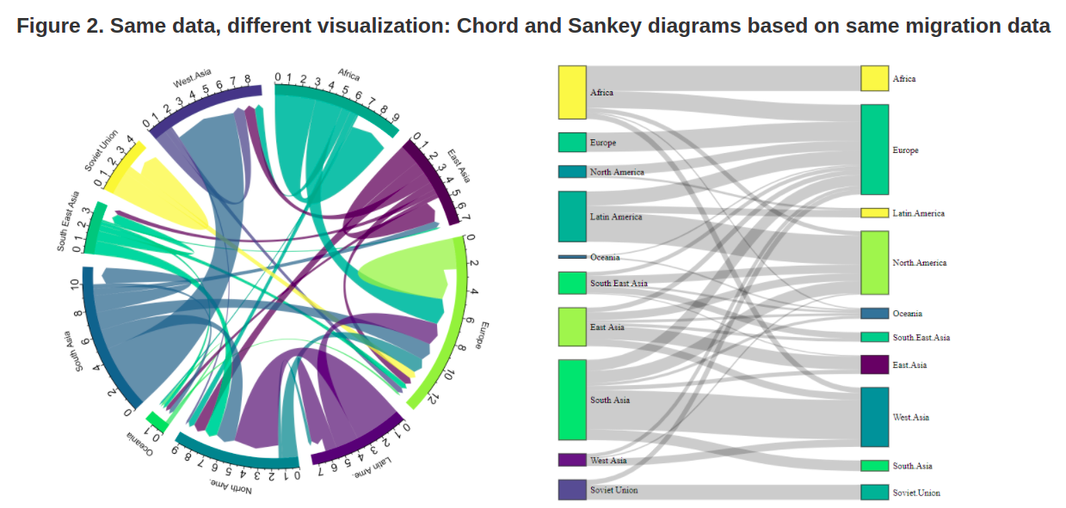
https://rpubs.com/YJ_Choi/FPDynamicsData
http://download.gsb.bund.de/BIB/global_flow/

Slide 43
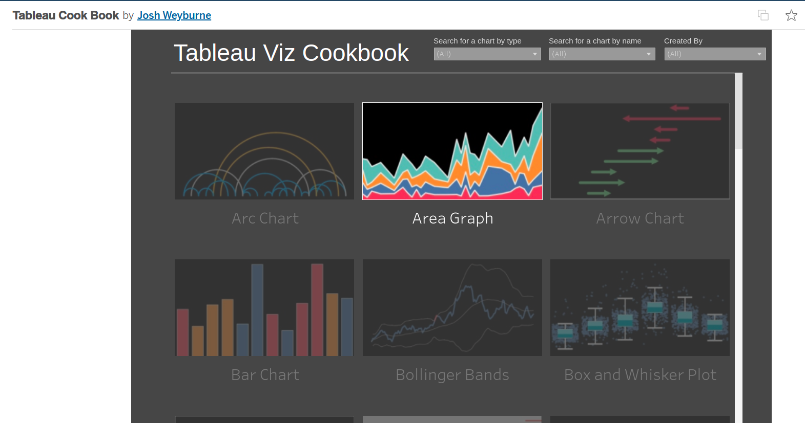
cookbook
https://public.tableau.com/app/profile/josh.weyburne/viz/CookBook/VizCookbook
Notes:
https://public.tableau.com/app/profile/josh.weyburne/viz/CookBook/VizCookbook

Slide 44
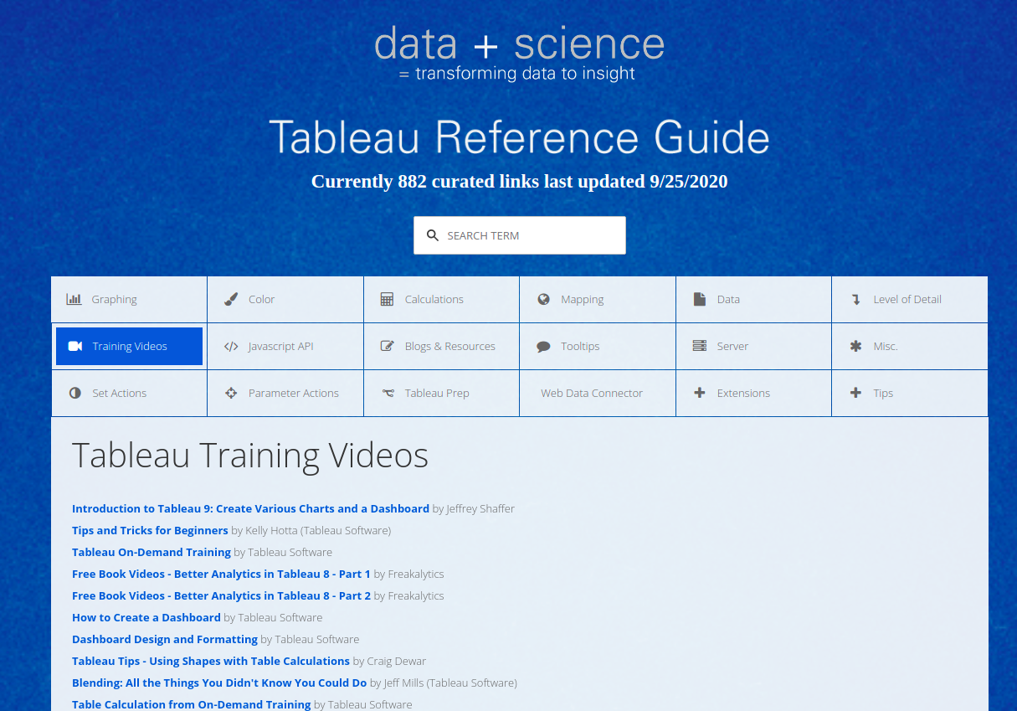
Notes:
http://www.tableaureferenceguide.com/

Slide 45
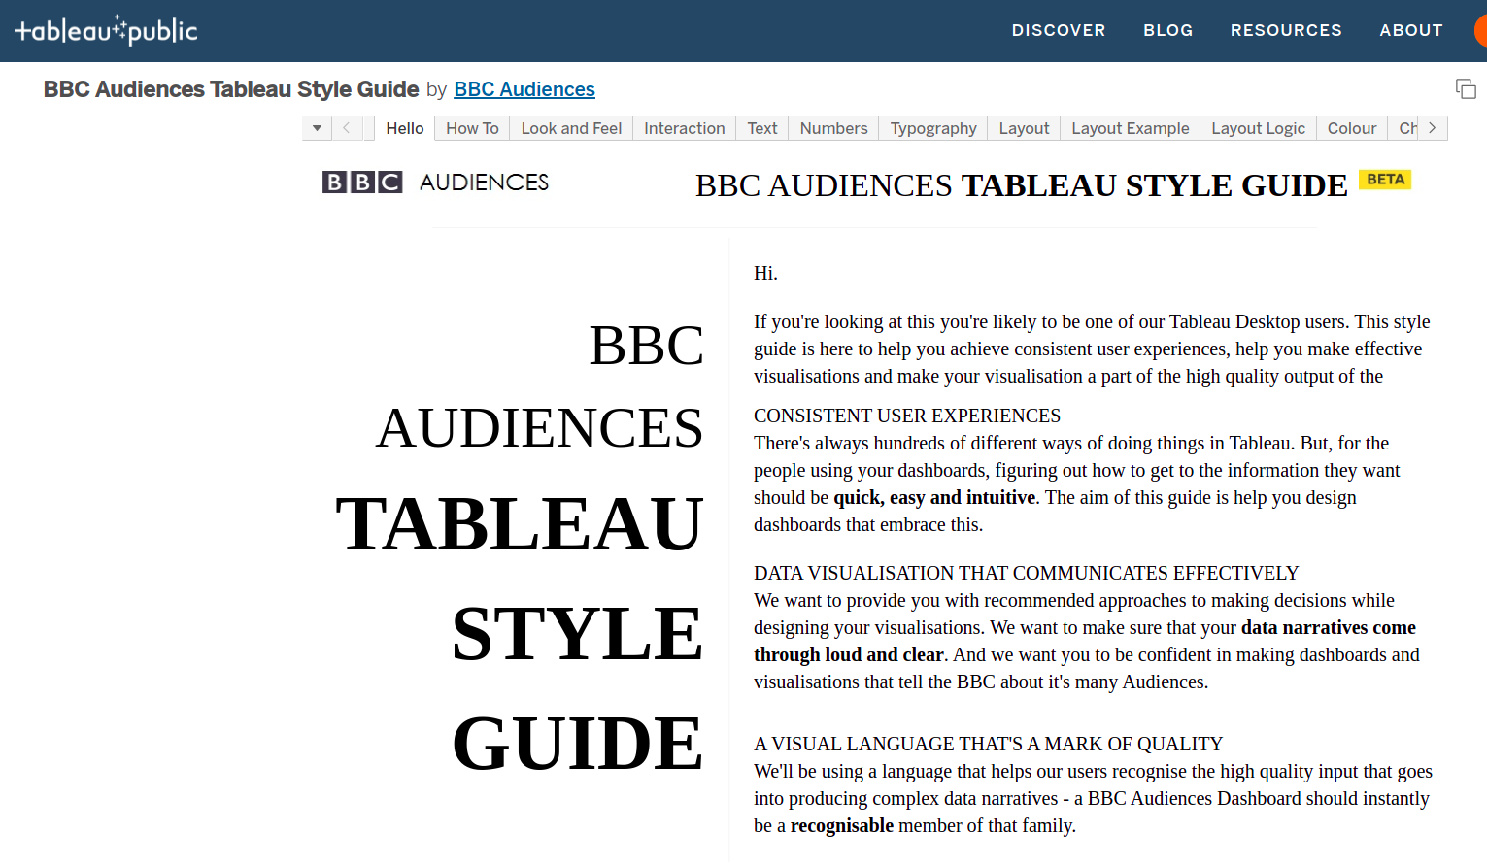
Style guide
Most probably I will delay this to discuss in depth concepts
Notes:
BBC Audiences Tableau Style Guide | Tableau Public
https://public.tableau.com/app/profile/bbc.audiences/viz/BBCAudiencesTableauStyleGuide/MoreInfo2

Slide 46
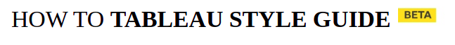

https://public.tableau.com/views/BBCAudiencesTableauStyleGuide/HowTo?%3Aembed=y&%3AshowVizHome=no&%3Adisplay_count=y&%3Adisplay_static_image=y

Slide 47

https://public.tableau.com/views/BBCAudiencesTableauStyleGuide/LayoutLogic?%3Aembed=y&%3AshowVizHome=no&%3Adisplay_count=y&%3Adisplay_static_image=y

Slide 48

Formatting
https://help.tableau.com/current/pro/desktop/en-us/formatting_worksheet.htm#Copy_and_paste_worksheet_formatting
https://help.tableau.com/current/pro/desktop/en-us/formatting_worksheet.htm#Copy_and_paste_worksheet_formatting

Slide 49
Non-aggregating numerical dimensions
https://campus.datacamp.com/courses/analyzing-data-in-tableau/preparing-for-analysis?ex=2

Slide 50
Dimensions and measures
https://campus.datacamp.com/courses/introduction-to-tableau/getting-started-with-tableau?ex=6

Slide 51
Segmenting using dimensions
https://campus.datacamp.com/courses/introduction-to-tableau/getting-started-with-tableau?ex=9

Slide 52

Exercise data validation

Slide 53

Preparing data

Slide 54
Cleaning up
https://campus.datacamp.com/courses/analyzing-data-in-tableau/preparing-for-analysis?ex=4

Slide 55
Calculating
https://campus.datacamp.com/courses/analyzing-data-in-tableau/preparing-for-analysis?ex=7

Slide 56
Slicing and dicing
https://campus.datacamp.com/courses/analyzing-data-in-tableau/preparing-for-analysis?ex=14

Slide 57
treemap
https://campus.datacamp.com/courses/analyzing-data-in-tableau/preparing-for-analysis?ex=16
Nice exercise

Slide 58
Solve it ur way
https://campus.datacamp.com/courses/analyzing-data-in-tableau/preparing-for-analysis?ex=18

Slide 59

Datacamp course
https://app.datacamp.com/learn/courses/case-study-analyzing-customer-churn-in-tableau

Slide 60

How to?
https://www.youtube.com/playlist?list=PL_t5OlLHbVGxFSiWXUsEQrDPvFd1Nhxiu

Slide 61
KimberlyFessel
https://www.youtube.com/watch?v=uZlMNUPA26E

Slide 62

Tailored training
https://www.tableau.com/learn/learning-quiz

Slide 63


project
???!

Slide 64

project

Slide 65

Dataset 3

Slide 66

Dataset 2

Slide 67


Slide 68

Rubric

Slide 69
https://review.udacity.com/#!/rubrics/1060/view

Slide 70




Dashboard layout

Slide 71
https://public.tableau.com/views/BBCAudiencesTableauStyleGuide/HowTo?%3Aembed=y&%3AshowVizHome=no&%3Adisplay_count=y&%3Adisplay_static_image=y

Slide 72
https://public.tableau.com/views/BBCAudiencesTableauStyleGuide/LayoutLogic?%3Aembed=y&%3AshowVizHome=no&%3Adisplay_count=y&%3Adisplay_static_image=y

Slide 73
Formatting
https://help.tableau.com/current/pro/desktop/en-us/formatting_worksheet.htm#Copy_and_paste_worksheet_formatting
https://help.tableau.com/current/pro/desktop/en-us/formatting_worksheet.htm#Copy_and_paste_worksheet_formatting

Slide 74

Want to learn more?
https://www.youtube.com/watch?v=96371LvULXM&list=PLRfaJ7ZL0cF5ByWSGPFbzdijOx0mv73TY

Slide 75


Tableau keyboard shortcuts
Try on a fancy worksheet from tableau public viz of day

Slide 76





More shortcuts
Calculated
field?
https://help.tableau.com/current/pro/desktop/en-us/shortcut.htm#shortcuts-for-managing-workbooks-sheets-and-files-tableau-desktop

Slide 77






Slide 78

Want to learn more?
https://www.youtube.com/watch?v=xRTzYyfSyDo&list=PLRfaJ7ZL0cF7U9cR7ORuueqxItw3qcno1

Slide 79


Slide 80




More shortcuts

Slide 81
Text tables with multiple measures
Just double click the measure

Slide 82


Slide 83



Slide 84




Drag!
Tableau will figure out the type of your file.

Slide 85





Slide 86

Want to learn more?
Add the link to the repo

Slide 87



Slide 88



solution

Slide 89




Slide 90





Slide 91



Slide 92


Slide 93





Slide 94

Want to learn more?

Slide 95





Slide 96



Add or remove subtotals
Remember to double click

Slide 97






Different aggregation

Slide 98






Slide 99






Slide 100

Notes:
https://www.youtube.com/c/sqlbelle/search?query=tips

Slide 101


Slide 102

https://www.youtube.com/watch?v=U7w1XumKK60&list=PLT0KU4DMyMtGdtsHmsGCrY9nRurA1UeER&index=2

Slide 103
Sets can’t be created from tableau online
Dialog box not appearing

Slide 104

Possible errata
I think Last answer should not be marked. In solution, it is marked

Slide 105


Discuss how to choose palette?
When to choose each of these?
Notes:
Choosing color palettes — seaborn 0.11.1 documentation
https://seaborn.pydata.org/tutorial/color_palettes.html
The most important function for working with color palettes is, aptly, color_palette(). This function provides an interface to most of the possible ways that one can generate color palettes in seaborn. And it’s used internally by any function that has a palette argument.
<number>

Slide 106

Vary hue to distinguish categories

Slide 107

Vary hue to distinguish categories
Notes:
Most people would be able to quickly ascertain that there are five distinct categories in the plot on the left and, if asked to characterize the “blue” points, would be able to do so.
<number>

Slide 108

Vary luminance to represent numbers¶
Notes:
With the hue-based palette, it’s quite difficult to ascertain the shape of the bivariate distribution. In contrast, the luminance palette makes it much more clear that there are two prominant peaks.
<number>

Slide 109
How to choose color palettes?
qualitative palettes
sequential palettes
diverging palettes

Slide 110



Qualitative color palettes

Slide 111




Sequential color palettes
lines and points?
Heatmaps?
Notes:
Some seaborn functions will default to a sequential palette when you are mapping numeric data. (For historical reasons, both categorical and numeric mappings are specified with the hue parameter in functions like relplot() or displot(), even though numeric mappings use color palettes with relatively little hue variation).
Perceptually uniform palettes
Because they are intended to represent numeric values, the best sequential palettes will be perceptually uniform, meaning that the relative discriminability of two colors is proportional to the difference between the corresponding data values.
Which one can be used for lines and plots?
Which can be used for heatmaps?
Left for heatmaps (colors approaching white would be useful for very low values – but they can’t map points or lines on a background)
<number>

Slide 112


Matplotlib – and reverse!
Notes:
It is also possible to use the perceptually uniform colormaps provided by matplotlib, such as "magma" and "viridis":
As with the convention in matplotlib, every continuous colormap has a reversed version, which has the suffix "_r":
<number>

Slide 113

Sequential Color Brewer palettes

Slide 114

Diverging color palettes
When to use?
Notes:
Seaborn includes two perceptually uniform diverging palettes: "vlag" and "icefire". They both use blue and red at their poles, which many intuitively processes as “cold” and “hot”:
<number>

Slide 115


Diverging palettes

Slide 116

Plotly
https://nbviewer.jupyter.org/github/plotly/plotly_express/blob/gh-pages/walkthrough.ipynb

Slide 117

Other side
Notes:
Plotly Express: the Good, the Bad, and the Ugly | by Reilly Meinert | Towards Data Science
https://towardsdatascience.com/plotly-express-the-good-the-bad-and-the-ugly-dc941649687c
<number>

Slide 118

Dtale
https://www.analyticsvidhya.com/blog/2021/06/exploring-pandas-dataframe-with-d-tale/
http://alphatechadmin.pythonanywhere.com/dtale/main/1

Slide 119
Breakout 1
https://www.kaggle.com/alexisbcook/scatter-plots

Slide 120

Advanced task
https://projects.datacamp.com/projects/441

